Slide 1
SOEN 390
Demo Sprint 4
Team #14:
Samantha Guillemette (26609198)
Mohammad Ali Zahir (40077619)
Saleha Tariq (40006997)
Laila Alhalabi (40106558)
Hoda Nourbakhsh (40066450)
Tushar Raval (40124664)
Quang Tran (27740654)
Marwa Khalid (40155098)
Steven Markandu (23740137)
Notes:
Sam: 4min
Quang: 4min
Ali: 2min
Tushar: 2min
Steve: 3-4min

Slide 2

Goals
Due to the current COVID-19 crisis, there needs to be a way to:
Enable doctors and patients to connect with each other
Government officials to keep track of those infected and in which areas
All while maintaining the privacy and confidentiality of those infected as much as possible
Notes:
Sam

Slide 3

Why Implemented?
Monitor patients infected with COVID-19.
Prioritize infected patients.
Eliminate overloading on the number of patients assigned per doctor.
Establish emergency communication between doctors and patients.
Lower the percentage of cases.
Notify clients about an exposure to COVID-19
Notes:
Sam

Slide 4
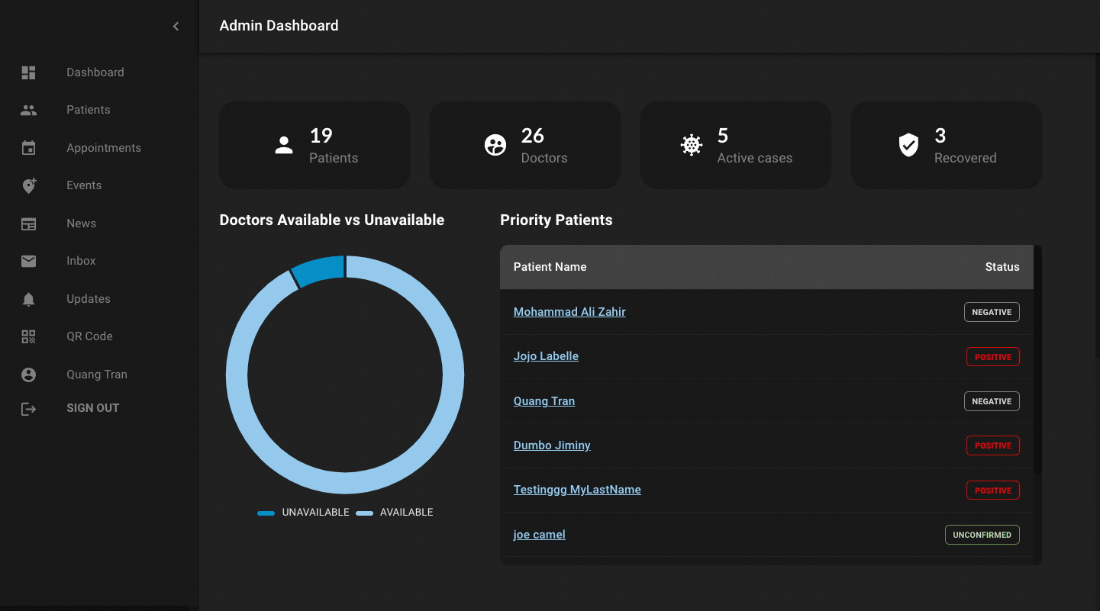
Admin App
Deployed link: https://admin-covidtracker.web.app/
Notes:
Sam

Slide 5
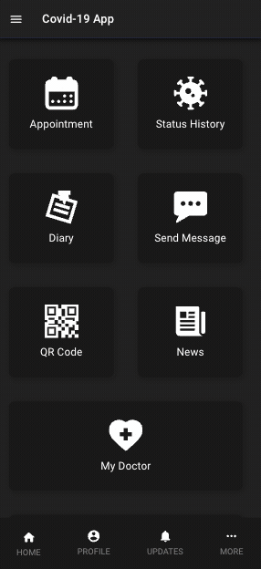
Client App
Deployed link: https://client-covidtracker.web.app/
Notes:
Sam

Slide 6
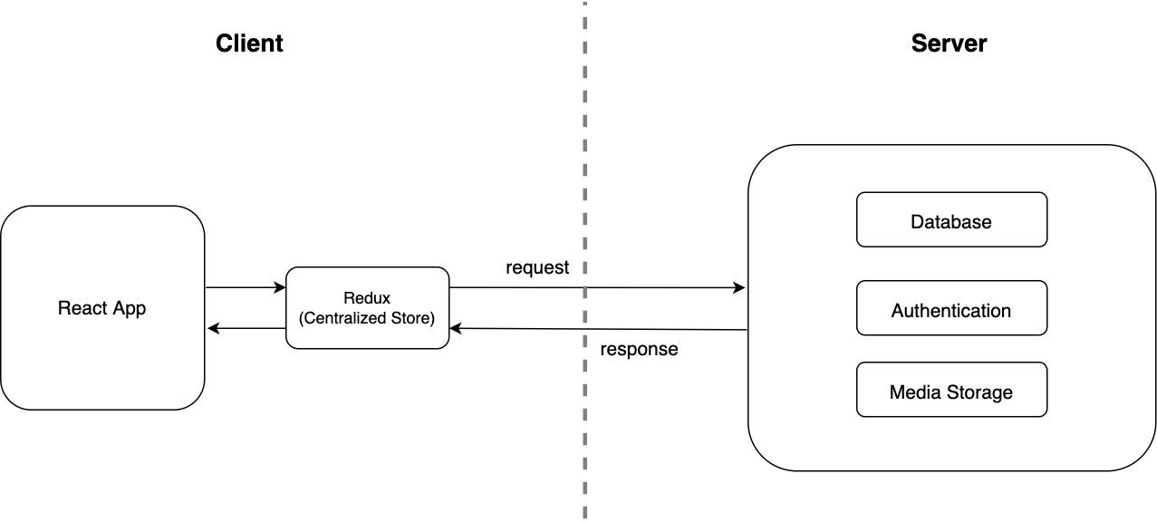
High-level overview
Notes:
Sam

Slide 7

Front-End
React
Chosen because it supports development for:
Mobile apps
web apps
Material UI
UI tool
Build a unified UI
Customize each component.
Notes:
Sam

Slide 8

Front-End - Why Dark Theme?
Our application displays a lot of data, the dark theme provides a handful of benefits:
It helps reduce eye strain
The contrast between white against a dark background makes it easier to process the data
Dark mode saves battery life
During sickness it is often difficult to look at screens, dark screens help with that
Notes:
Sam

Slide 9
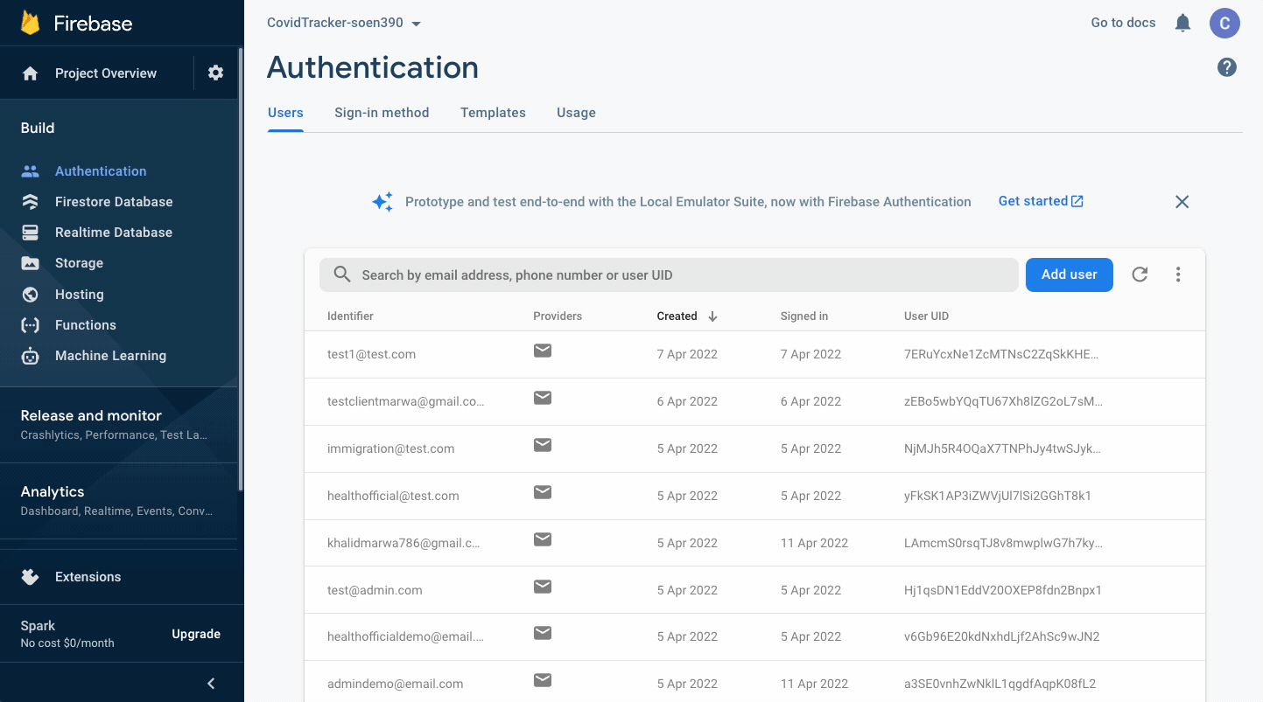
Back-End - Database Used
Firebase used for backend
NoSQL database
Selected because:
Had previous experience in other projects
Easy to implement
Free
Also used for authentication
Notes:
Steve

Slide 10
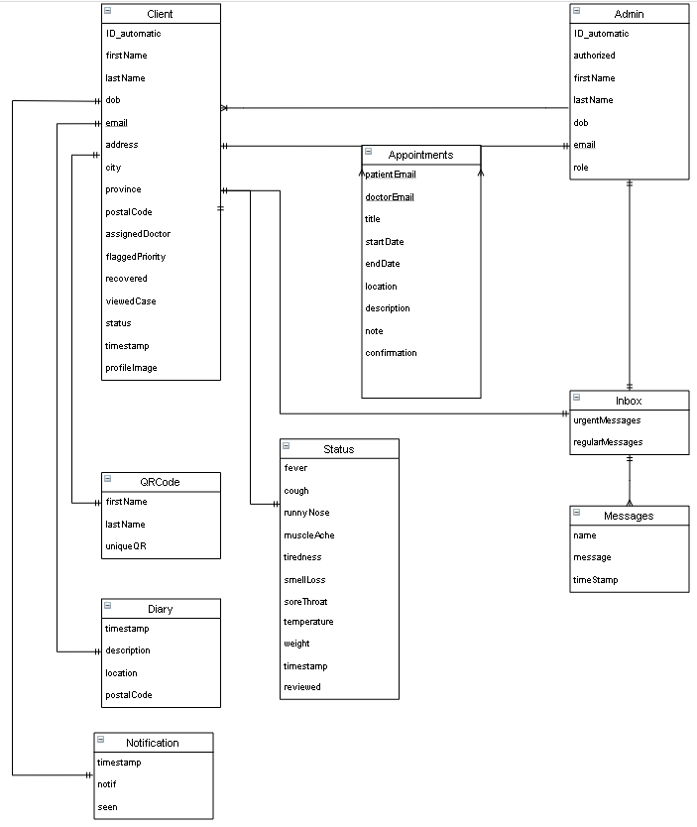
Back-End - Structure
Root collections created for:
Client (Patient)
Admin
Doctors
Heath Official
Immigration Officer
Administrator
Super Administrator
News
Relationship collection created for:
DoctorPatient
Contains info for appointments
Notes:
Steve

Slide 11
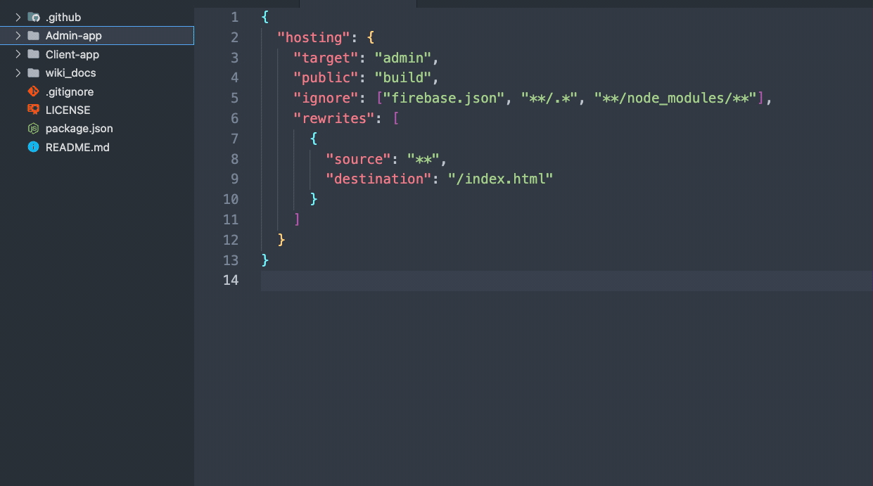
Back-End - Code
For most of the code accessing the DB:
Location under “<App>/backend” directory (both apps):
File created for each main entity
ie. firebasePatientUtilities, firebaseDoctorUtilities, etc.
Created with the idea that the functions are treated as a “black-box”
ie. no real DB experience required
Just need to know:
Entity you need to access
Key to access a specific item
Notes:
Steve

Slide 12

Implemented User Stories
For both Admin-app and Client-app
Notes:
Quang

Slide 13
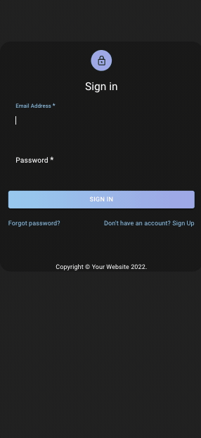
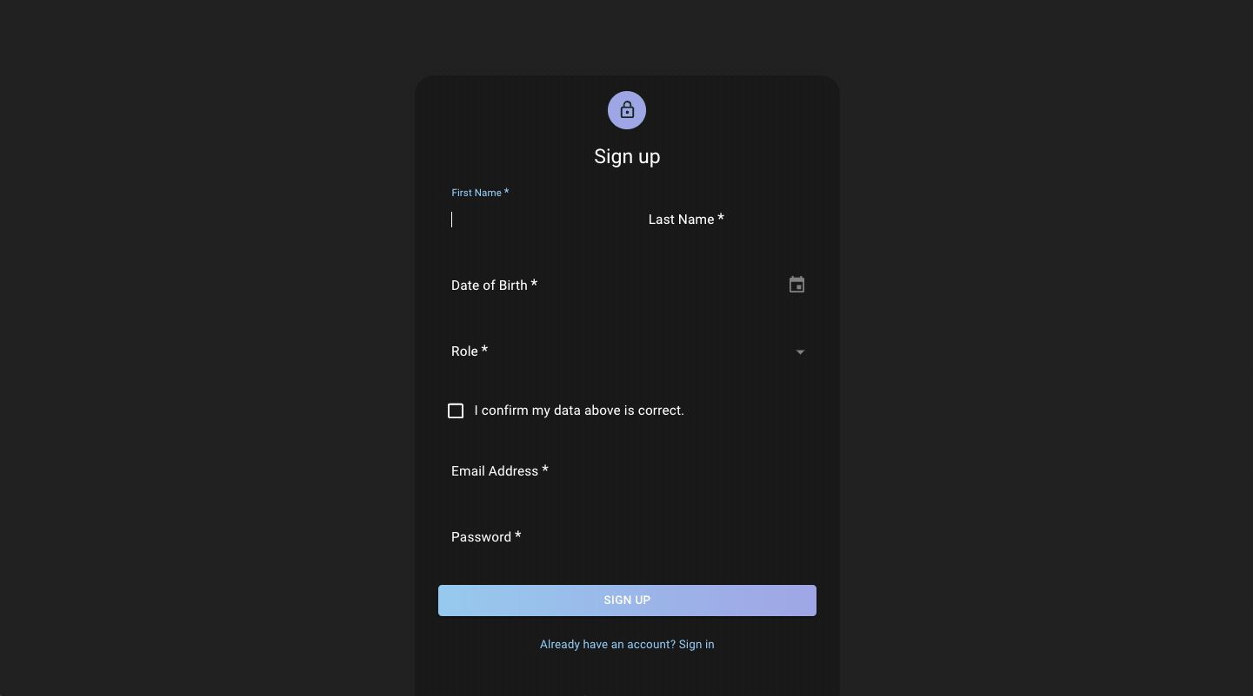
Login/Signup
Dashboard view
Notes:
Quang
Mention which roles see which screens

Slide 14
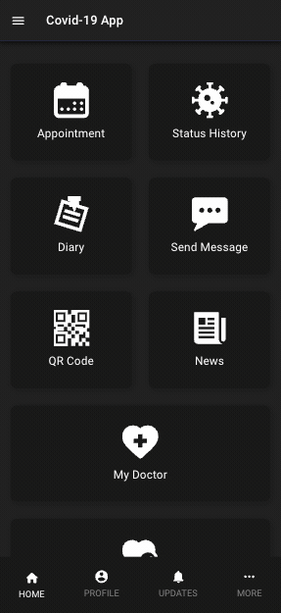
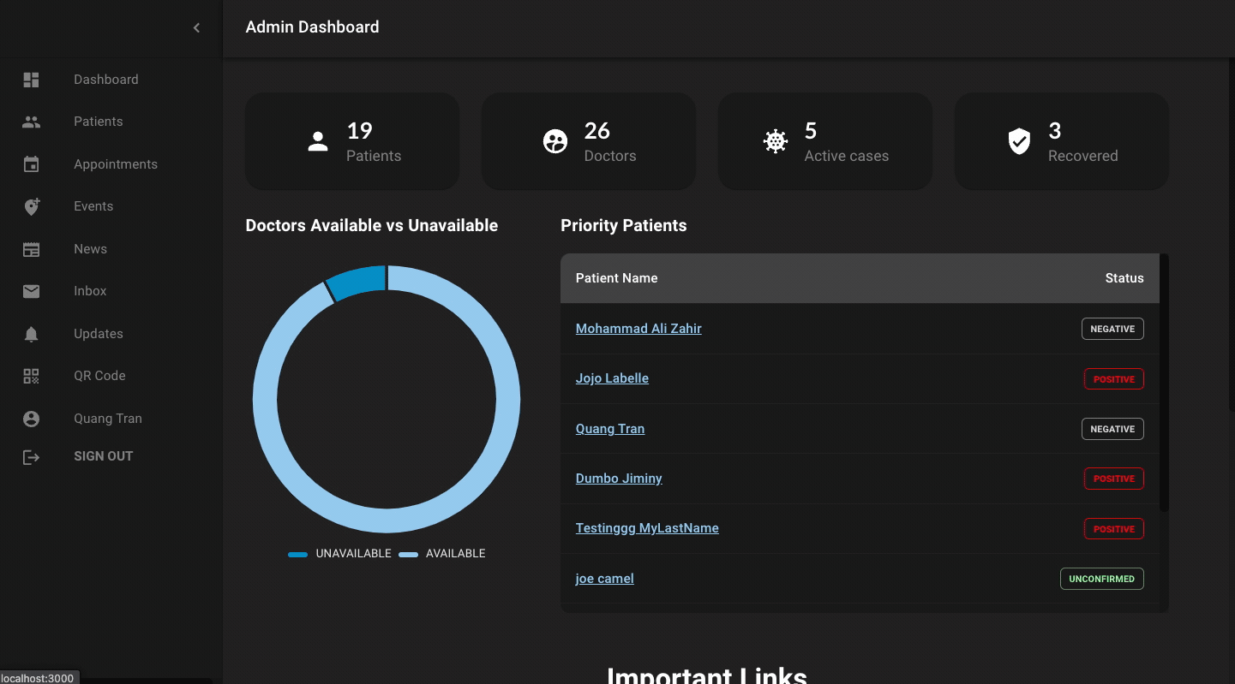
Communication between doctor & patient
Notes:
Quang
Mention which roles see which screens

Slide 15
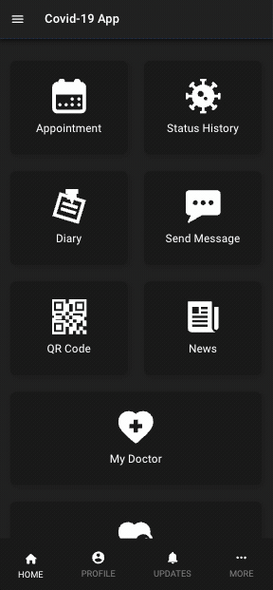
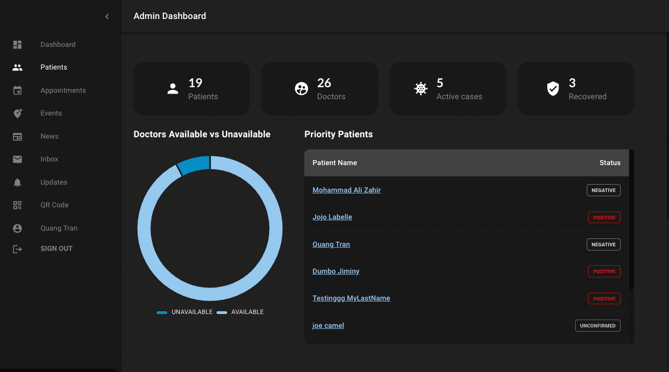
Appointment system for doctor & patient
Notes:
Quang
Mention which roles see which screens

Slide 16
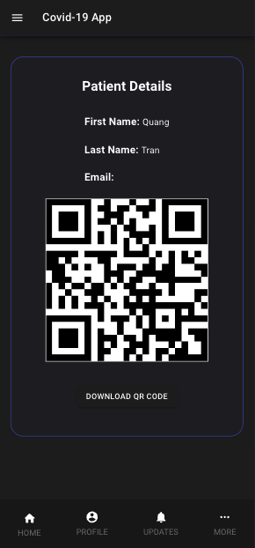
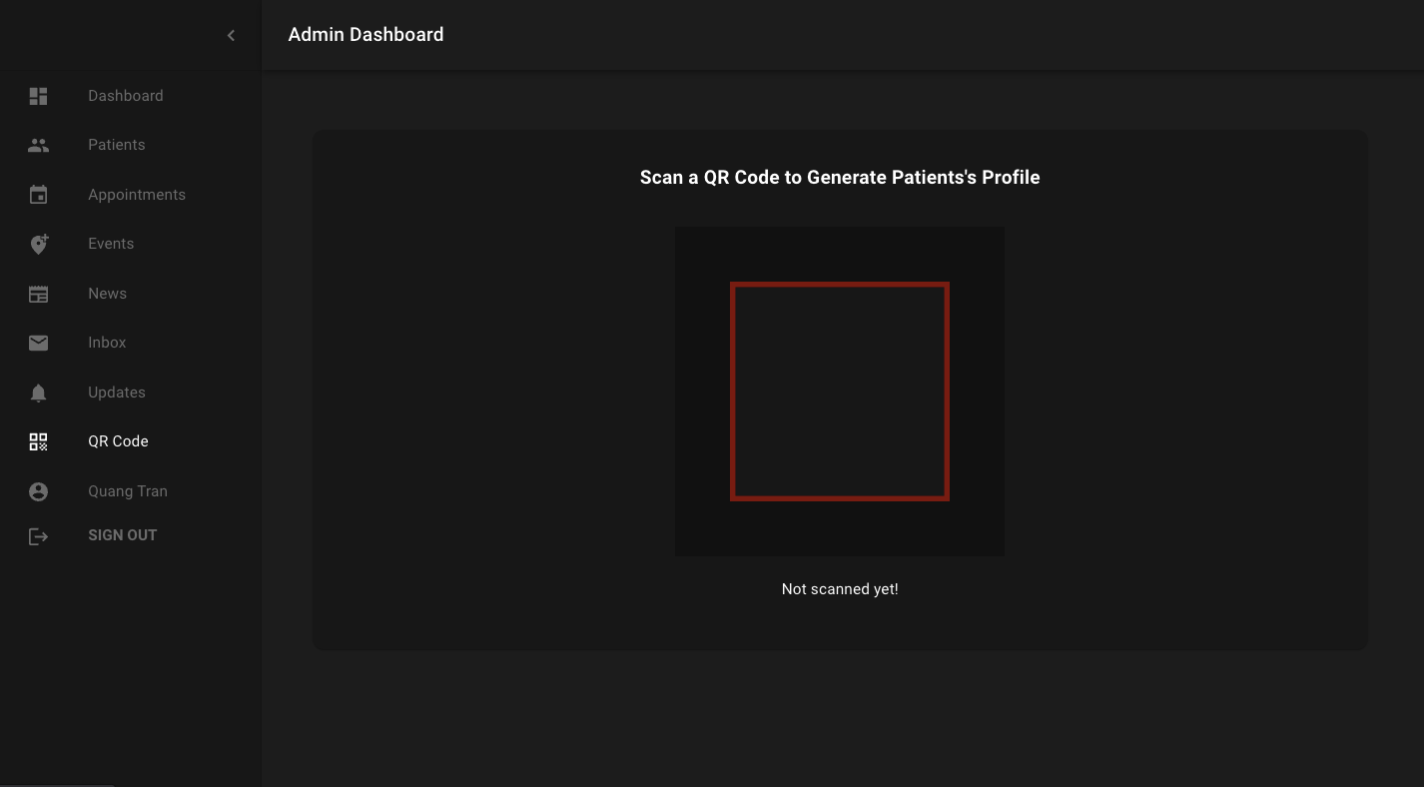
Create and scan QR code
Notes:
Quang
Mention which roles see which screens

Slide 17
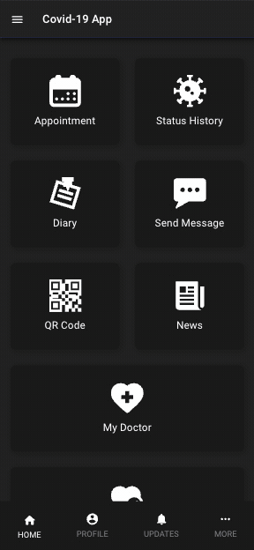
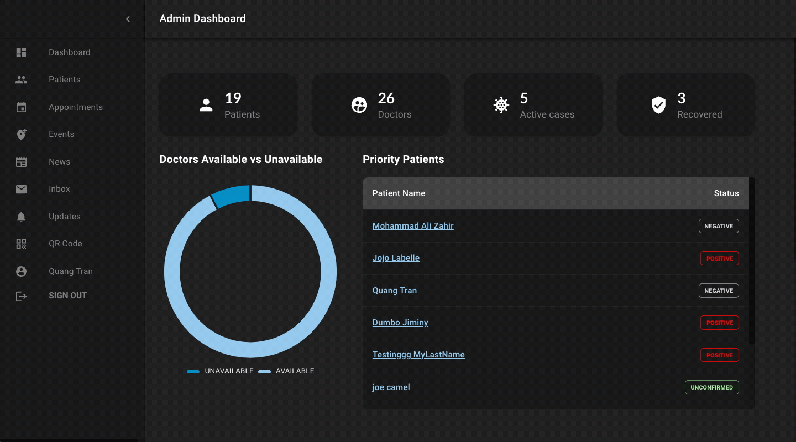
[Doctor] Notify doctor when status is re-updated on the same day.
[Patient] Trace & notify patients for potential covid infection.
[Patient] Notify Covid-19 patients to update status daily
Notes:
Quang
Mention which roles see which screens

Slide 18

Implemented User Stories
For Admin-app only
Notes:
Quang

Slide 19
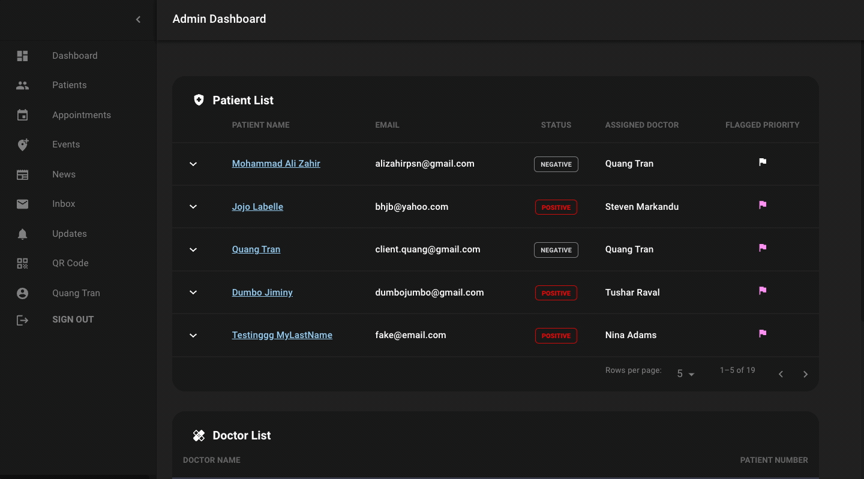
Prioritize (flag) a patient.
Identify how many patients are assigned to each doctor.
Assign (and reassign) doctors to patients.
Notes:
Quang
Mention which roles see which screens

Slide 20
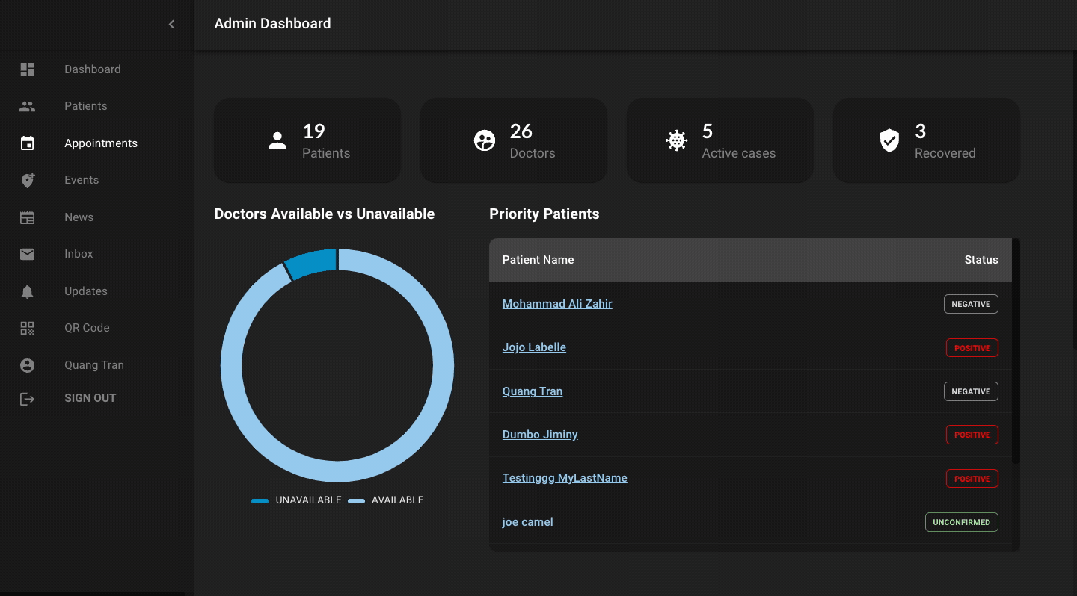
List of all patients and display details each patient.
Monitor status & symptoms of patients.
View the history of symptoms for each patient.
Mark patient’s status updates as ‘reviewed’.
Notes:
Quang
Mention which roles see which screens

Slide 21
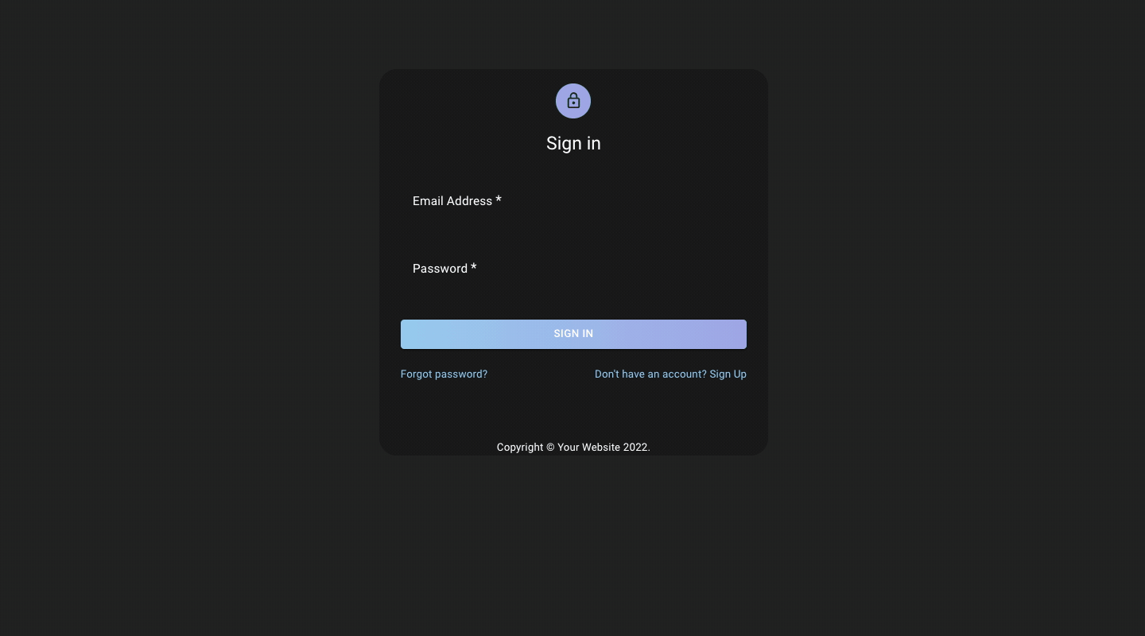
Different visibilities for different admin users.
Allow super admins to view & manage other admin accounts.
Notes:
Quang
Mention which roles see which screens

Slide 22
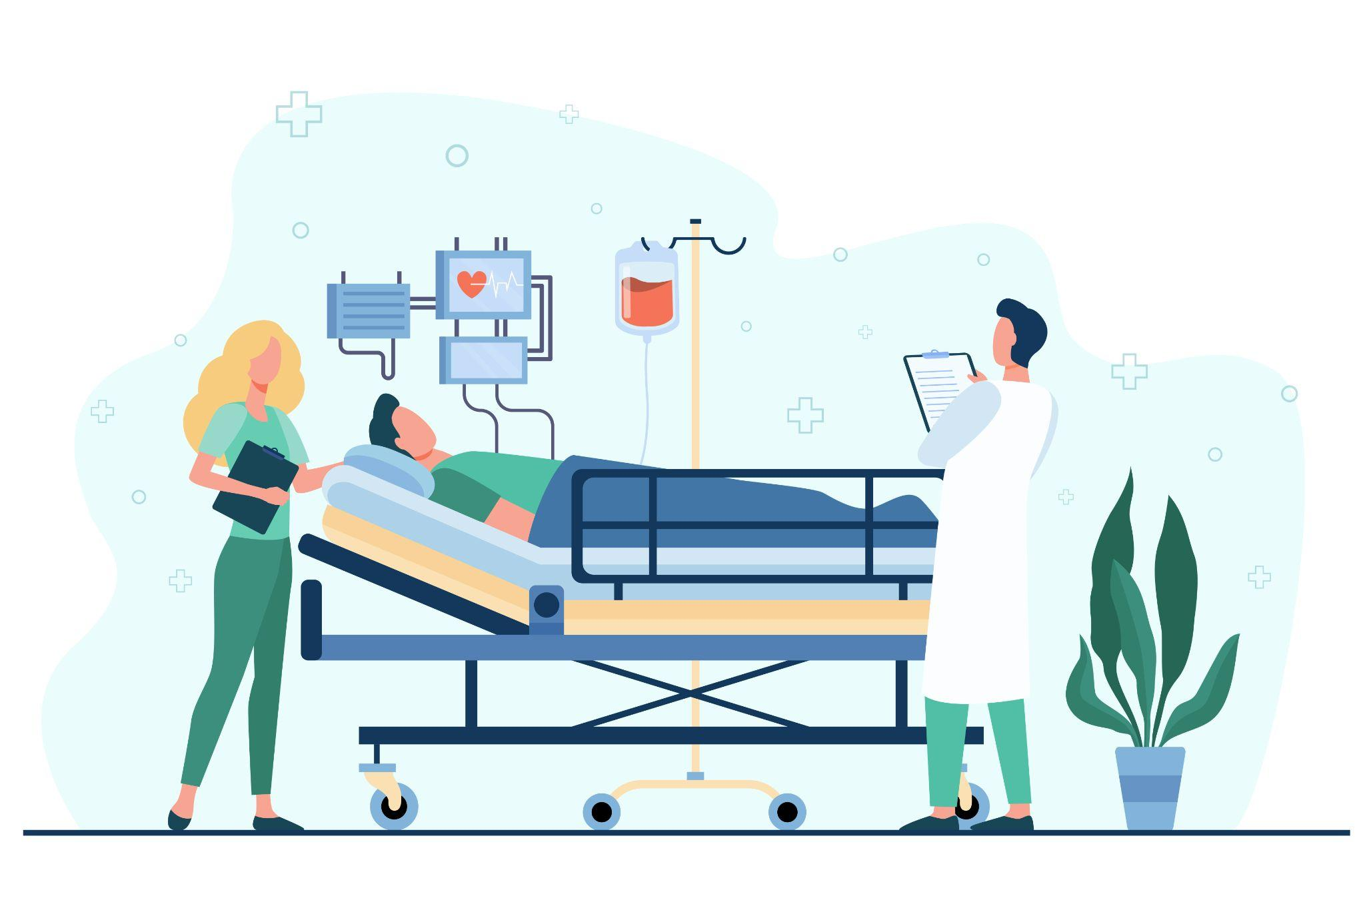
Implemented User Stories
For Client-app only
Notes:
Quang

Slide 23
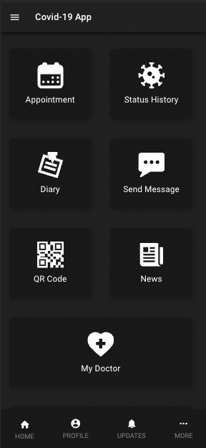
Allow patient to view the basic info of the assigned doctor.
Status history (and diary) page for patients
Notes:
Quang
Mention which roles see which screens

Slide 24
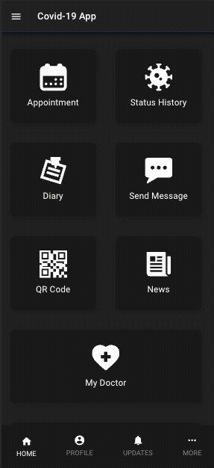
Editable profile page for patients
Notes:
Quang
Mention which roles see which screens

Slide 25


Testing
Tools used:
Jest
Used for unit testing and integration testing
Unit tests run as part of our pipeline (Github actions)
Ensures that PR doesn’t break branch
Ensure that most components created in both apps have some kind of tests
Cypress
Used for system (end to end) testing
Allows for automatic testing of the code based on clicks and keyboard inputs
Notes:
Ali

Slide 26
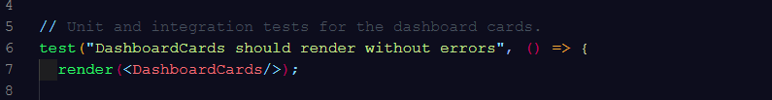
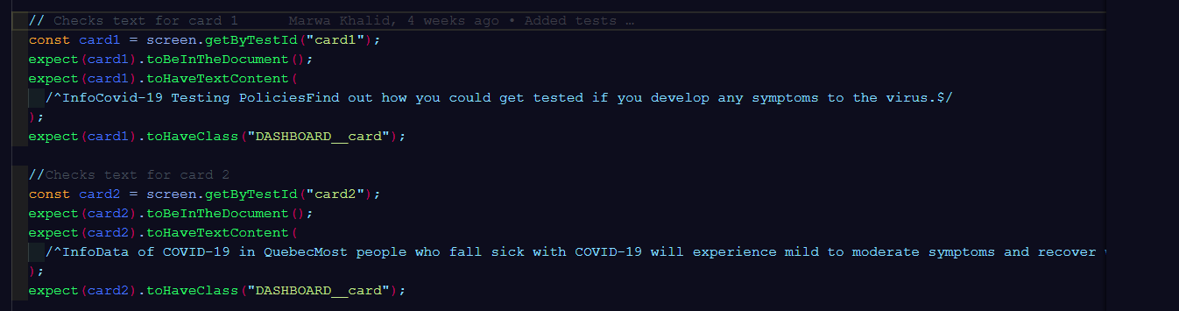
Unit / Integration Tests
Unit test: calling and testing the function components
Admin : 24 unit tests
Client: 14 unit tests
Integration test : calling a specific role or component in the function
Admin : 19 integration tests
Client: 6 integration tests

Slide 27
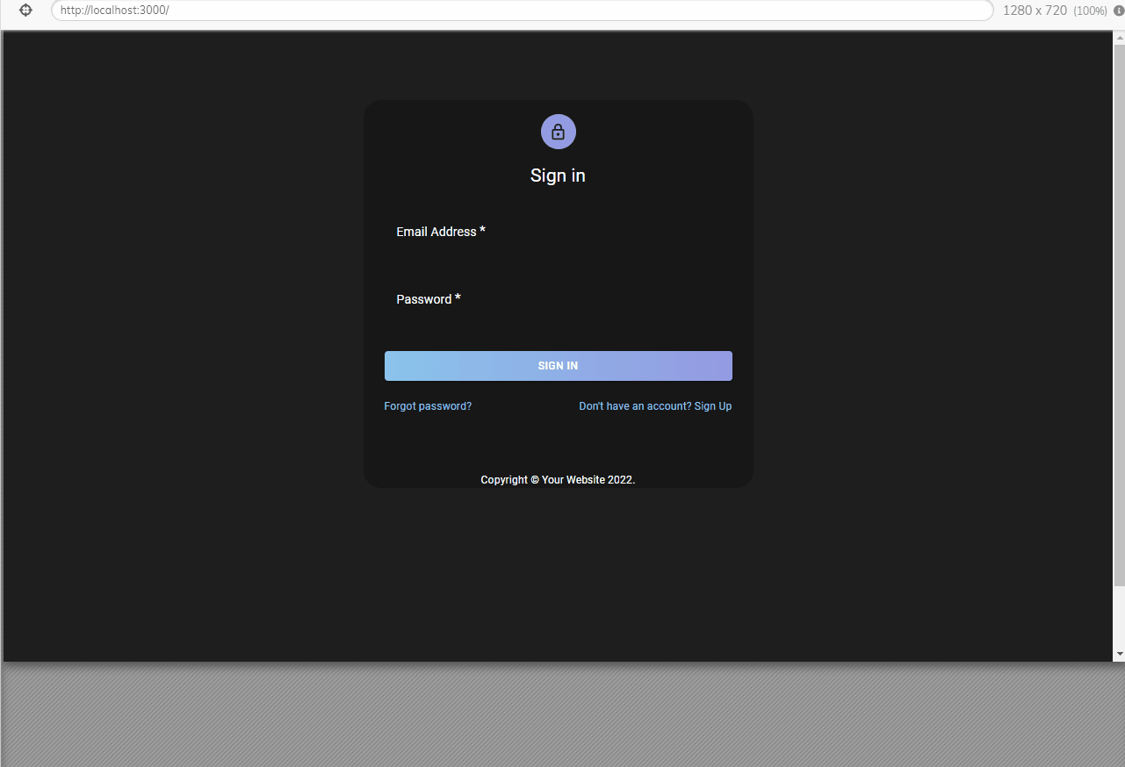
System Tests
Test every component possible through the use of Cypress
Admin : 5 system tests
Client: 3 system tests

Slide 28
Code Coverage - Current Stats
Generated using Jest
Admin-app
Client App
Notes:
Ali

Slide 29

Code Coverage - Improving
All values currently below 50% (our minimum goal)
Ways to increase this:
More test cases that cover
More pages being called
More functions tested
More branches covered
Code cleanup to eliminate:
Pages/functions/branches that are never called
Notes:
Ali

Slide 30

What’s next?
List of User Stories to be implemented in the future:
Allow patient to:
View message from the assigned doctor via notification panel
Allow doctor to:
View list of assigned patients & past assigned patients
Change status of patient to non-patient
Allow health officer to:
View statistics (number of patients for each district daily, etc)
Introduce a light mode theme to:
Provide a choice between dark and light mode
Notes:
Tushar

